Slide 1


Designing genomic sequences
Cheng Soon Ong | 9 November 2021 Director Machine Learning and Artificial Intelligence Future Science Platform
Presented to Online Asian Machine Learning School (OAMLS) 2021
e cheng-soon.ong@data61.csiro.au
https://research.csiro.au/mlai-fsp/
Notes:
Key message: Figure out how to use machine learning to assist researchers in scientific discovery.

Slide 2
Given some data
Classify blue plus vs red triangles, based on features

Slide 3
Fit a model to data
Estimate a Gaussian for each class conditional

Slide 4
Build a classifier
Compute the posterior probability of blue plus

Slide 5
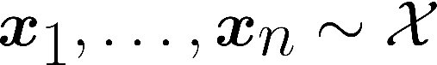
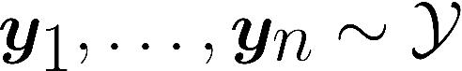
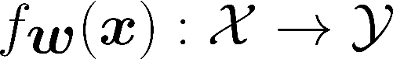
What is Machine Learning?
Machine Learning is about prediction
Examples/covariates/features
Labels/annotations/target variable Predictor
Estimate the best predictor = training
No mechanistic model of the phenomenon
There are many examples
The outcomes (labels) are well defined (usually binary)

Slide 6
What to do with a predictor?

Slide 7
What is Machine Learning?
Assume we have managed to train a sensible predictor
Machine Learning is about prediction
Examples/covariates/features
Labels/annotations/target variable Predictor
Estimate the best predictor = training
No mechanistic model of the phenomenon
There are many examples
The outcomes (labels) are well defined (usually binary)

Slide 8

Taking action
Assume that domain knowledge is captured by a predictor
Use predictor to decide where to measure (ABCDE)
(A) Active Learning
(B) Bandits / Bayesian Optimisation
(C) Choice Theory
(DE) Design of Experiments
Not discussed today
Bayesian inference
Causal interventions
Reinforcement learning

Slide 9
A – Active Learning
Want to build a classifier without paying for a lot of labels
Tran, Ong, Wolf, Combining active learning suggestions, PeerJ 2018

Slide 10
B – Bandits / Bayesian Optimisation
Want to maximise the outcome of different choices
Krause, Ong, Contextual Gaussian Process Bandit Optimization, NIPS 2011

Slide 11
C – Choice Theory
Want to integrate different sources of information
Bedo, Ong, Multivariate Spearman's rho for Aggregating Ranks Using Copulas, JMLR 2016

Slide 12
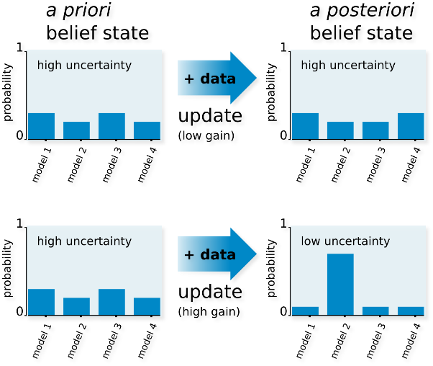
DE – Design of Experiments
Find good models by maximizing information gain
Busetto, et. al. Near-optimal experimental design for model selection in systems biology, Bioinformatics 2013

Slide 13

ABCDE: what are we sorting?
A conceptual view of adaptive sampling
Consider the set of all possible things to measure
Think of the predictor output as a generator of features
Each generated feature demonstrates the “importance” of a sample
Can get multiple features by a committee or ensemble of predictors
Adaptively choose the next thing to measure by maximising an objective (machine learning is about defining good objective functions)
regularizer
sparsity
bandwidth

Slide 14
ABCDE – what are we sorting?
Illustration of the conceptual idea
Predictor generates features
Define an objective function
A – Active Learning
Predictor generates a confidence that thing is positive
Objective is to find the location where probability = 0.5
B – Bandits / Bayesian Optimization
Predictor generates a model of the reward
Objective combines the summary statistic and uncertainty
C – Choice Theory
Predictor transforms scores into a comparable scale
Objective maximises a multivariate copula score
DE – Design of Experiments
Predictor estimates the expectation over future experiments
Objective identifies the notion of information gain

Slide 15
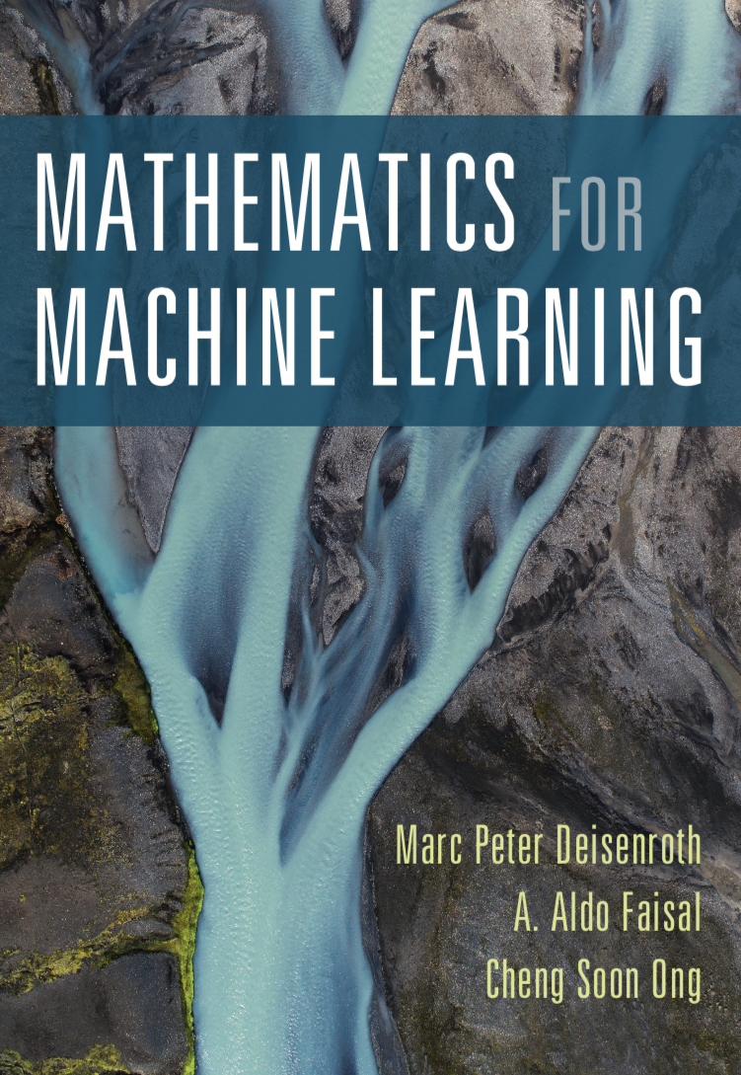

Thank you!
Cheng Soon Ong
e cheng-soon.ong@data61.csiro.au
w ong-home.my
https://research.csiro.au/mlai-fsp/
mml-book.com

Slide 16
Assume that domain knowledge is captured by a predictor
Use predictor to decide where to measure (ABCDE)
(A) Active Learning
(B) Bandits / Bayesian Optimisation
(C) Choice Theory
(DE) Design of Experiments
Let’s look here

Slide 17
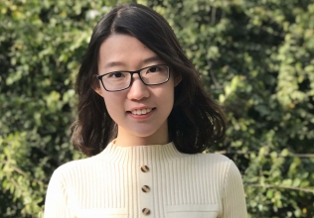


Machine Learning guided Design
of Ribosome Binding Sites
Mengyan Zhang, ANU
Maciej Holowko, L&W
Huw Hayman
Zumpe, SynBio

Slide 18
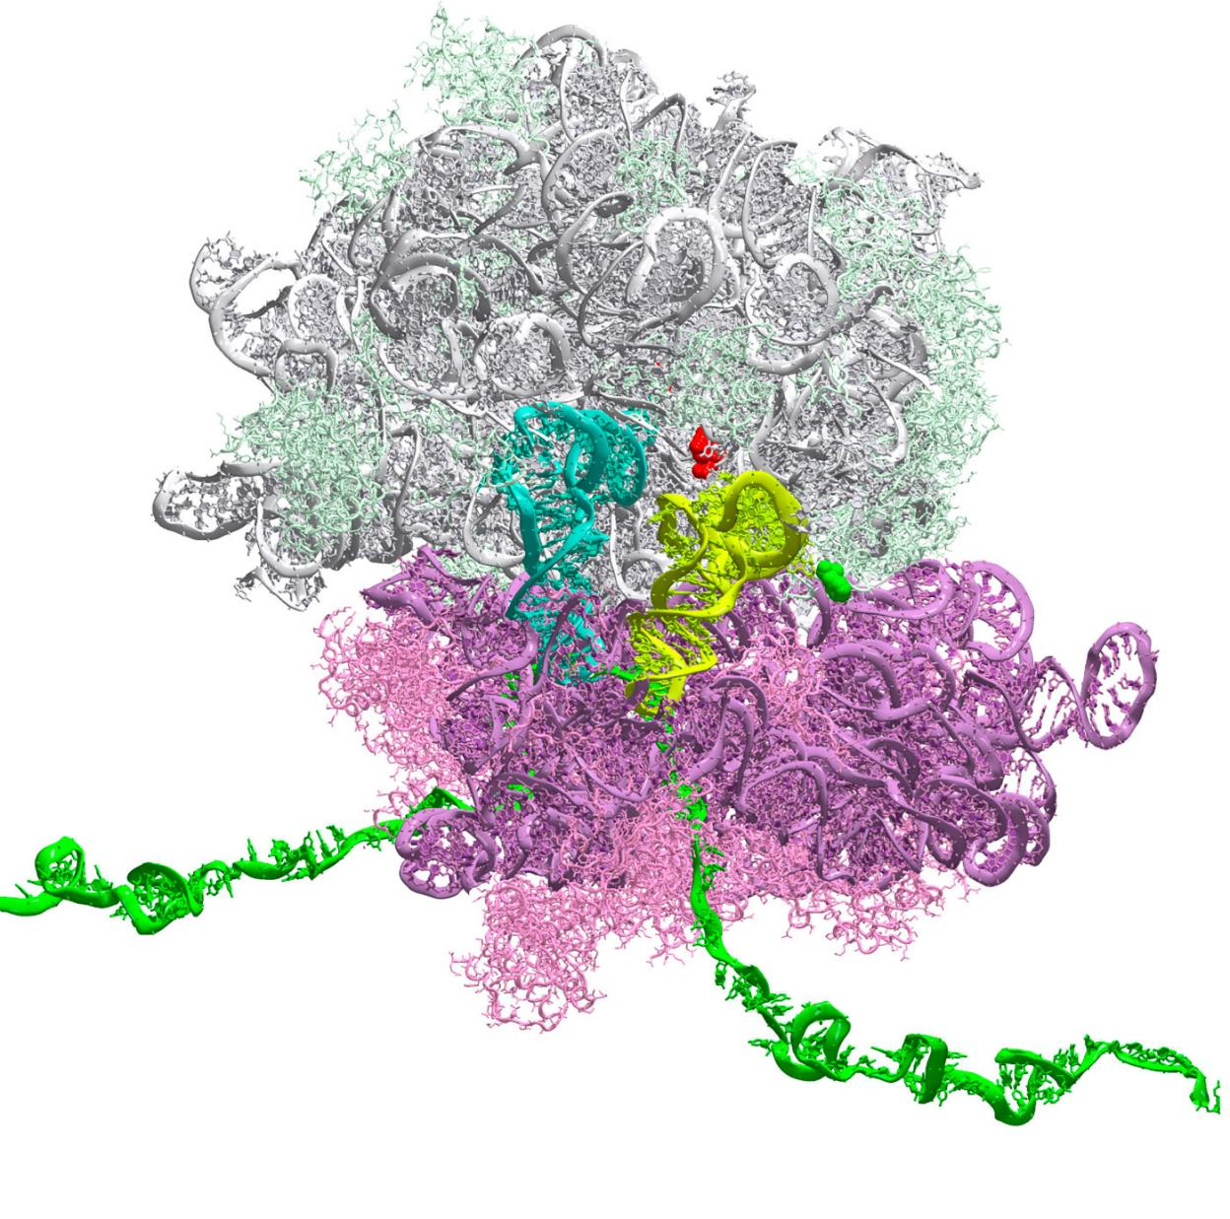
The RBS Problem
Ribosome Binding Site (RBS) controls protein expression level
Translation Initiation Rate of Ribosome (TIR) binding sites is hard to predict and is expensive to label
RBS calculators are based on thermodynamic data

Slide 19
What’s the objective?
Design Ribosome Binding Site (RBS) sequences
Optimize the protein expression level.
RBS sequence | Normalized* Protein Expression Level
TTTAAGAGTTATATATACAT | 1.58
TTTAAGAATATGCTATACAT | 1.42
TTTAAGACTCGGATATACAT | 0.14
TTTAAGAGTTTTTTATACAT | 2.88
Core part (design space): $4^{6}$ = 4096 possibilities in total
* zero mean and unit variance normalization $z=\frac{x−μ}{σ}$

Slide 20
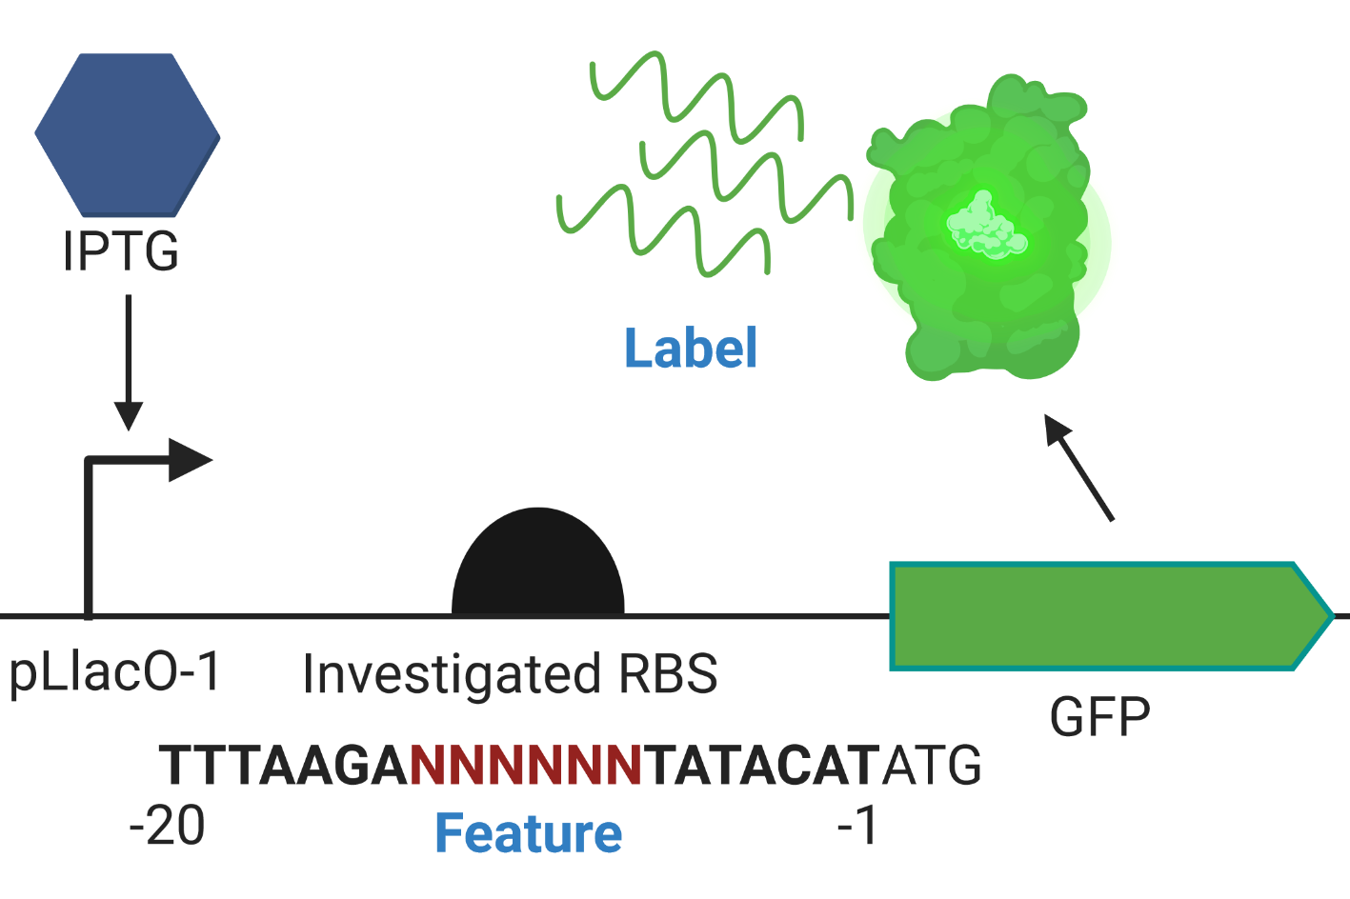
Genetic Device Design
hν
Notes:
RNA fold

Slide 21
Representing Sequences
Machine Learning methods need numbers
Convert an RBS sequence (e.g. AGAAGA) → a vector of real numbers
Represent k-mer counts
Weight by length k
Allow for small shifts (up to 2 bases) when looking for matches
We used a weighted degree kernel with shifts
AGA | GAA | AAG | AAA | …
2 | 1 | 1 | 0 | 0

Slide 22
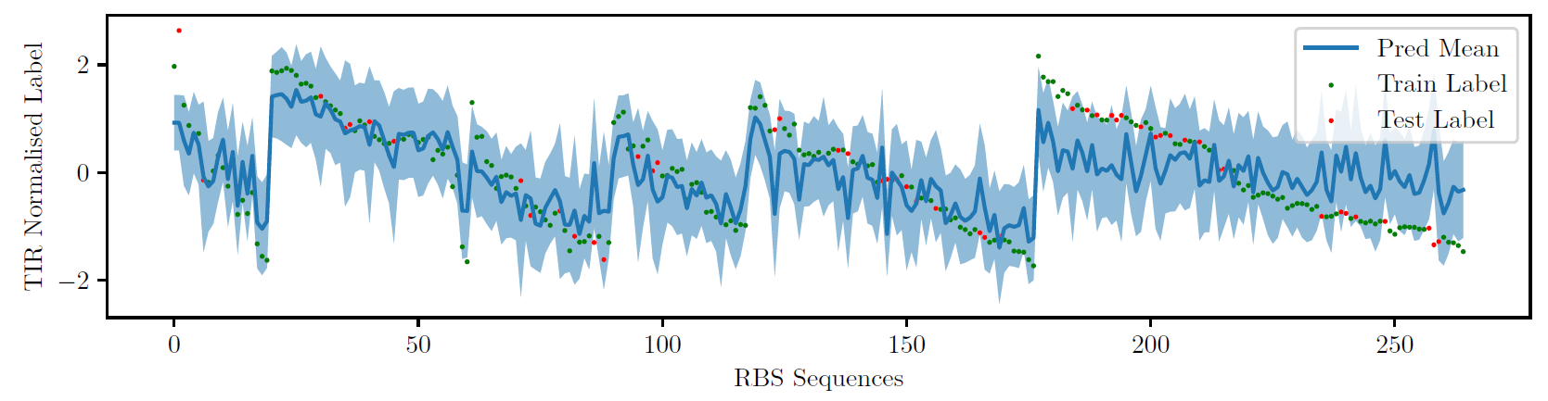
Gaussian process regression
A regression model that includes predictive uncertainty
https://distill.pub/2019/visual-exploration-gaussian-processes/
Linear regression
Uses a kernel for the covariance function
Calculates predictive uncertainty

Slide 23
ABCDE: Bandits
We want to design a RBS that maximises TIR

Slide 24
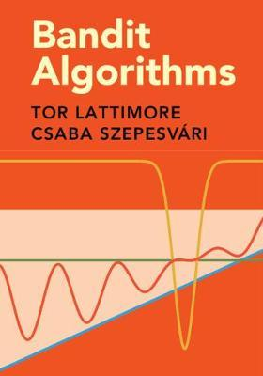
Anatomy of a Bandit Algorithm
Several design choices
Given a set of arms, at each round:
Choose an arm (and get a reward)
depending on the task at hand
Estimate the distribution of the arm
Assumption needed for theoretical analysis
Usually skipped in the algorithm
Define a summary statistic for each distribution
usually the mean for risk neutral policy (Von Neumann-Morgenstern utility theory)

Slide 25
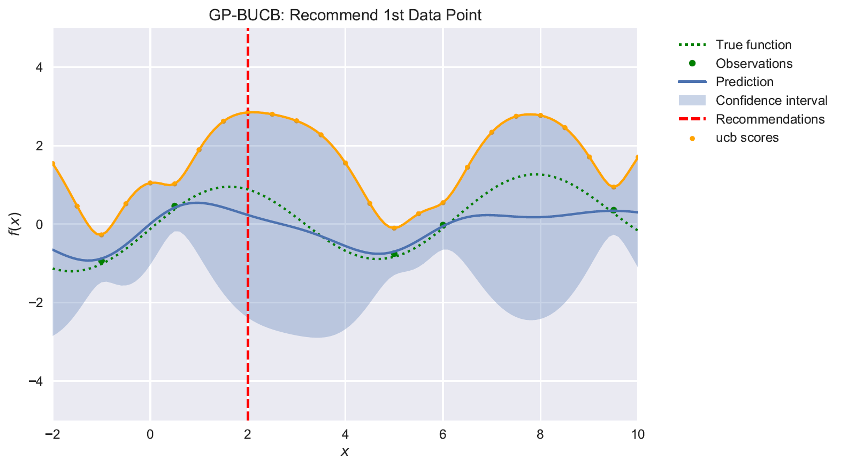
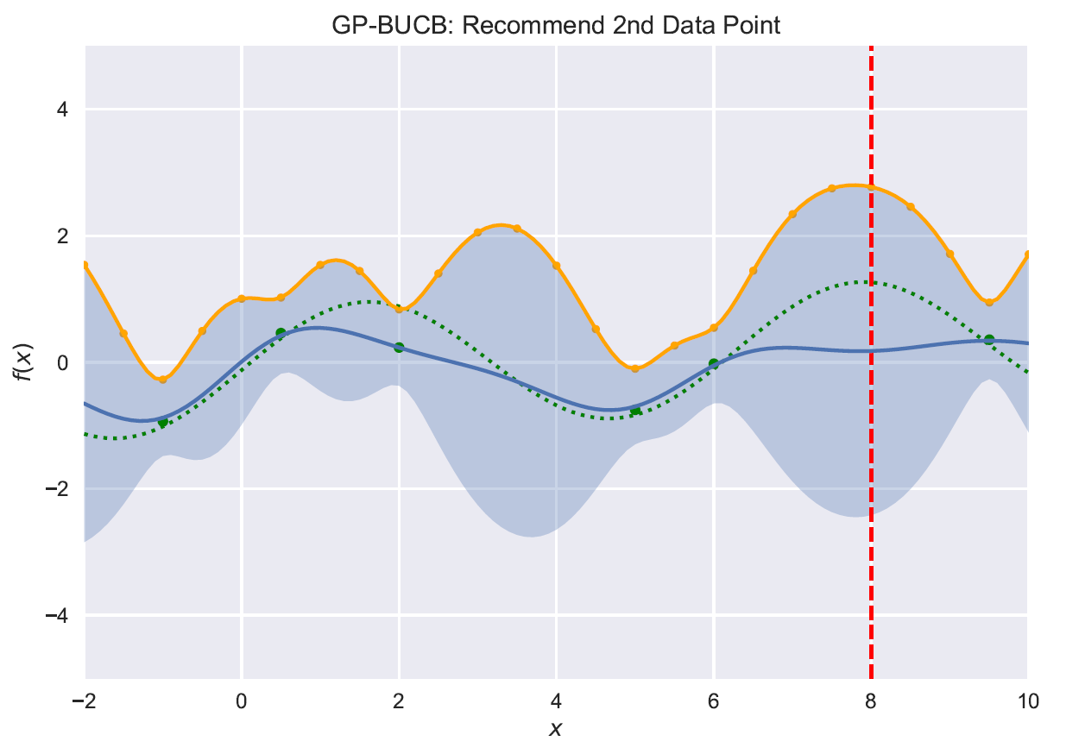
Upper confidence bound
A particular bandit algorithm
Desautels, Krause, Burdick, Parallelizing Exploration-Exploitation Tradeoffs in Gaussian Process Bandit Optimization, JMLR 2014

Slide 26
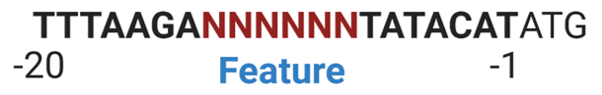
Practical challenge
How do we perform lots of TIR measurements (within budget)?
6 positions, 4 bases per position = 4096
Likely that many RBS sequences give low translation rates
Want to only try a small fraction
Sequences very similar to consensus likely to perform well, but worse than consensus
Interesting to consider drastically different core RBS sequence
High throughput experiments needed

Slide 27


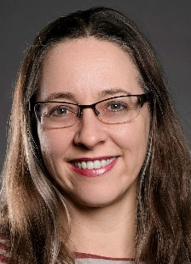
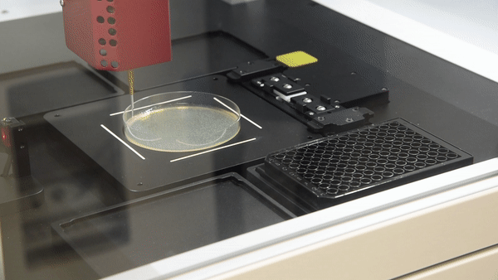
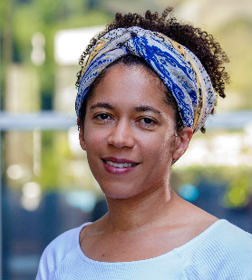

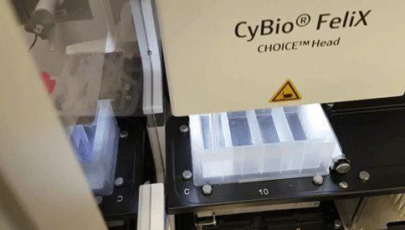
MLAI augmented SynBio
Working definition of ‘synthetic biology’: The design and construction of DNA-encoded parts, devices, machines, and organisms; and their application for useful purposes.
Experimental science domains
Integrative Biological Modelling
Engineering Novel Biological Components
Assembling Novel Biosystems
Application areas
Mosquito borne diseases
Bacterial biofilms
Chemical synthesis using yeast
Claudia Vickers
https://research.csiro.au/synthetic-biology-fsp
Janet Reid
Alison Rice
Notes:
CSIRO has invested in another Future Science Platform on Synthetic Biology.
(read slide for rest)

Slide 28
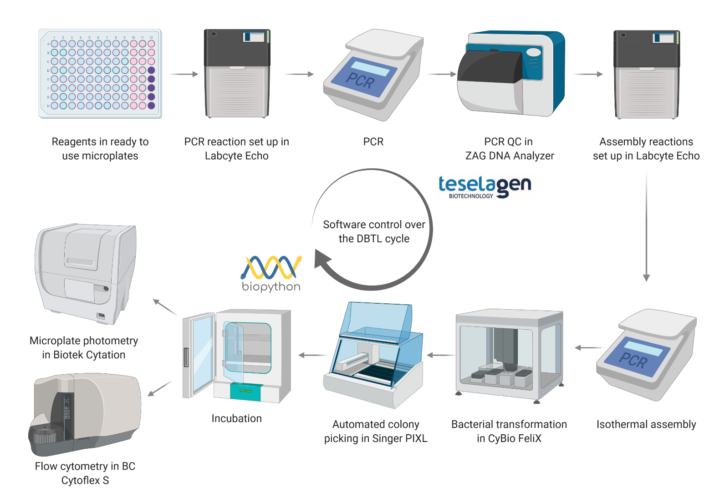


High-throughput RBS engineering
Notes:
FACS-SEQ

Slide 29
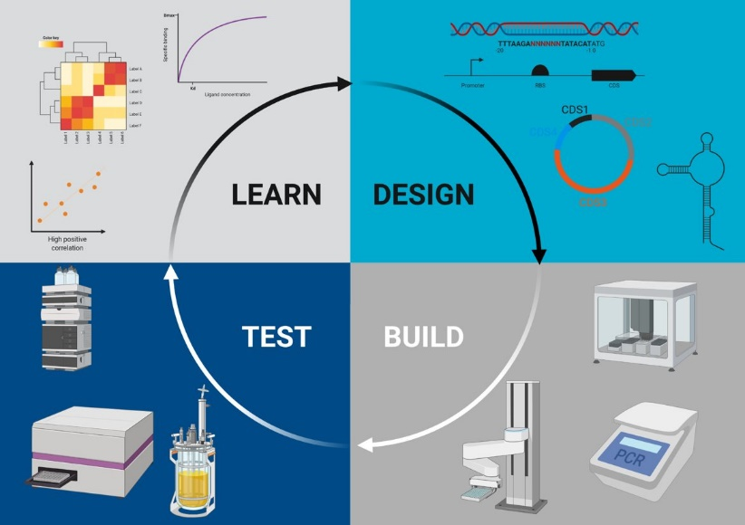
Algorithms
1. A (Bayesian) regression algorithm which predicts both
Mean
Uncertainty
2. An online/batch algorithm which recommends sequences to design
Gaussian Process Regression
(aka Kriging)
LEARN
Multiarmed Bandits Algorithms:
Upper Confidence Bound
DESIGN

Slide 30
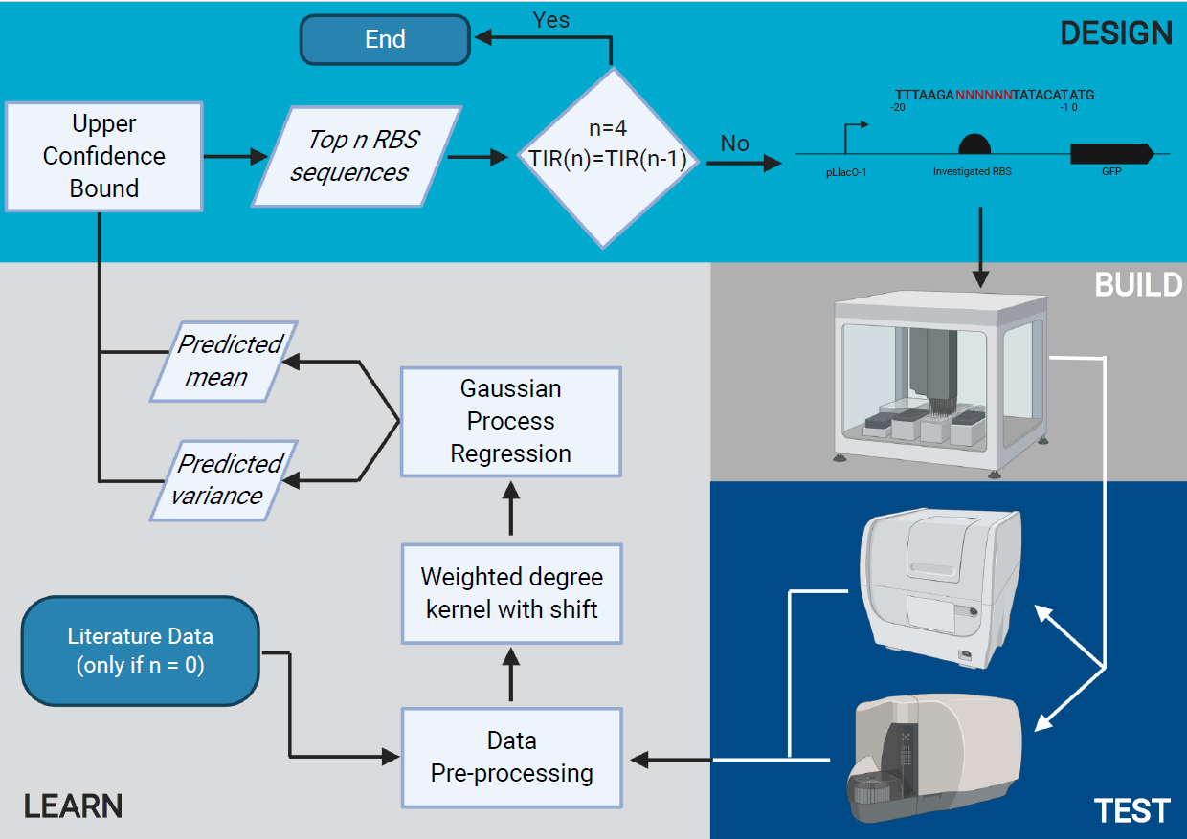
Overall workflow
Mengyan Zhang, ANU
Maciej Holowko, L&W
Huw Hayman
Zumpe, SynBio

Slide 31
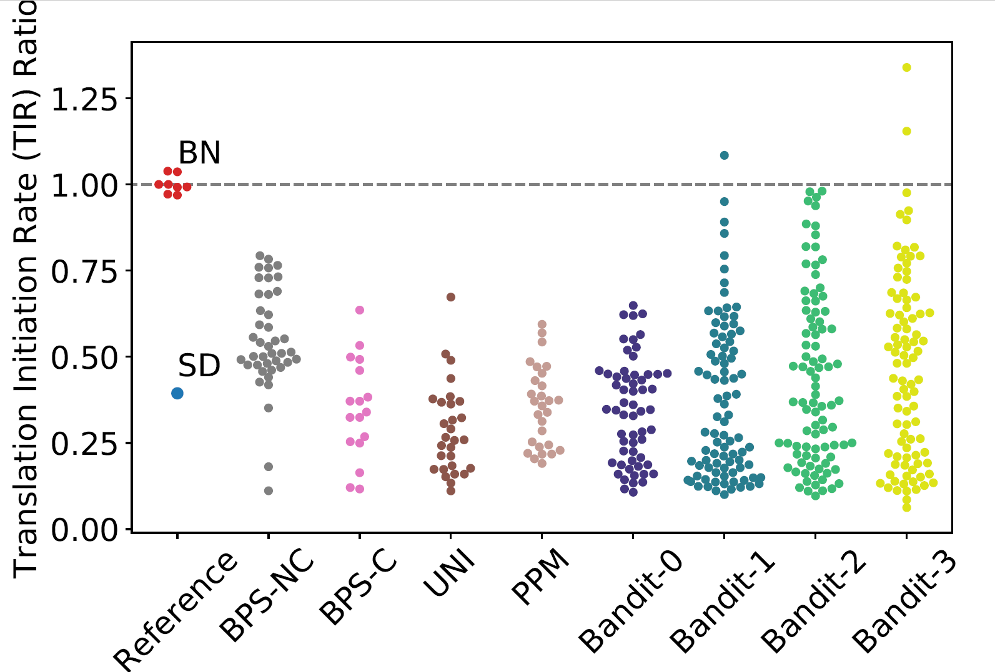
Designs of RBS
Consensus: AGGAGG
BPS: change one base
Random:
UNIform
Position Probability
Bandit:
0 – Thermodynamic trained
1,2,3 – Trained on previous data

Slide 32
Results on TIR
One base pair change results in lower TIR
Core region important
Random search not good
Position weighting better
Transfer learning hard
Bandits encouraging
Zhang, Holowko, Hayman Zumpe, and Ong, Machine learning guided design for ribosome binding site. Under revision

Slide 33
Exploration-Exploitation Trade-off
Exploration: unknown (untested) RBS design space with potentially high label
Exploitation: querying areas that are predicted to give relatively high labels.
4

Slide 34
Opportunities and Challenges
Measurement Noise and Data Normalisation
Exploitation-Exploration Trade-off
Representation of Biological Sequences
Generalisation of Our Workﬂow
Evaluation and Interpretability
Interdisciplinary Collaboration
https://icml-compbio.github.io/2021/papers/WCBICML2021_paper_8.pdf

Slide 35
Machine learning for scientific discovery
Cheng Soon Ong | 9 November 2021 Director Machine Learning and Artificial Intelligence Future Science Platform
Presented to Online Asian Machine Learning School (OAMLS) 2021
e cheng-soon.ong@data61.csiro.au
https://research.csiro.au/mlai-fsp/
Notes:
Key message: Figure out how to use machine learning to assist researchers in scientific discovery.

Slide 36
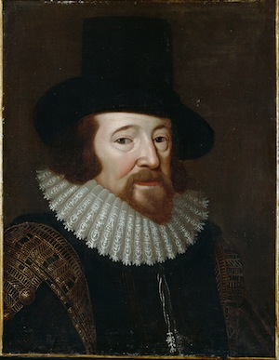
What is scientific discovery?
Observation
Francis Bacon, credited with the modern scientific method
Experimentation

Slide 37

Scientific discovery with machine learning
https://research.csiro.au/mlai-fsp/

Slide 38
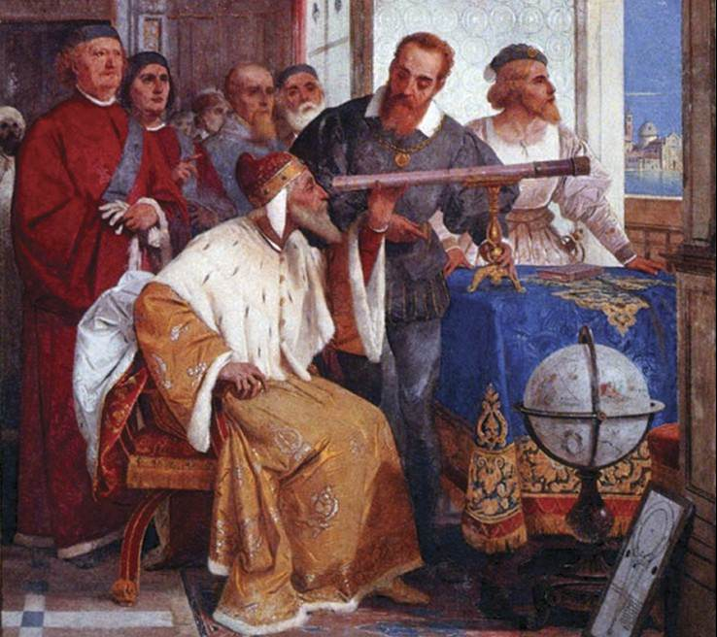
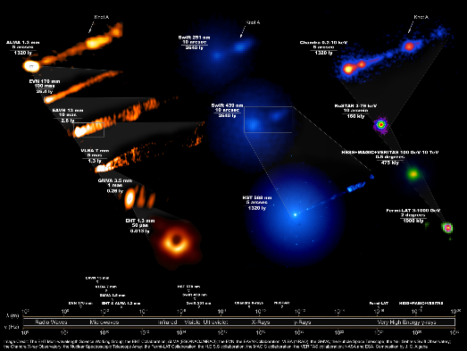
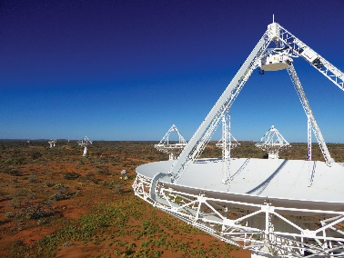
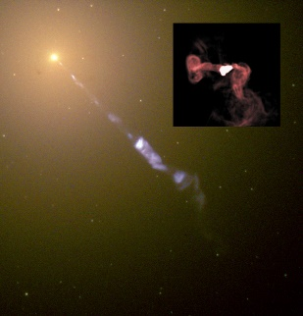
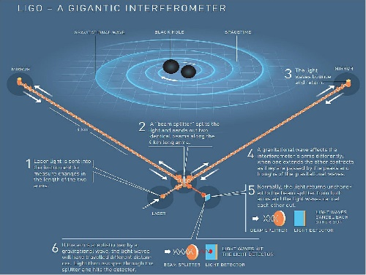
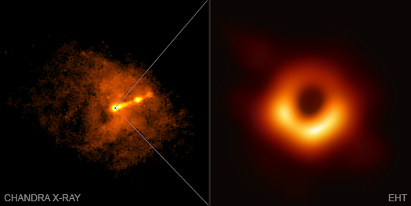
What is a Telescope?
Modern telescopes are essentially data processing machines
Galileo
Radio
Multi messenger
CSIRO - SKA
eventhorizontelescope.org
Giuseppe Bertini (1858)
NASA/Hubble + NRAO: M87

Slide 39

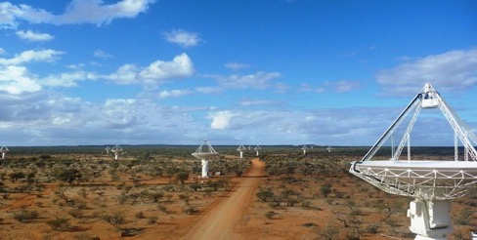
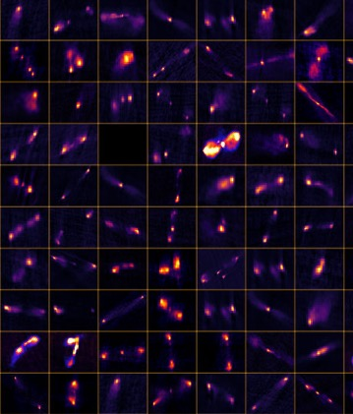
Classification of Radio Galaxies
ML/AI Open Questions and Considerations
Astronomy images are noisy
How to best preprocess?
Have both faint and bright features
Supervised or Unsupervised?
Radio Galaxy Zoo labels (~177k galaxies)
Apply transfer learning?
Train on simulated data
Train on one radio dataset, use on data from a different telescope
Notes:
There are some open questions and considerations around this ML task:
Astronomy images are mostly noise
Questions around how do we preprocess the image, so that the features are seen by the network. Astronomical images can have both bright and faint features.
Questions around whether to use supervised or unsupervised techniques. Do not have labels for all data of course – from RGZ project we have labels for 177k galaxies. Have project using unsupervised self-organised maps to do the radio source component grouping. Showing promise.
Can we apply transfer learning? Train on one radio dataset and use the model on another dataset? Telescopes have different properties such as resolution and sensitivity, and observe at different frequencies.

Slide 40
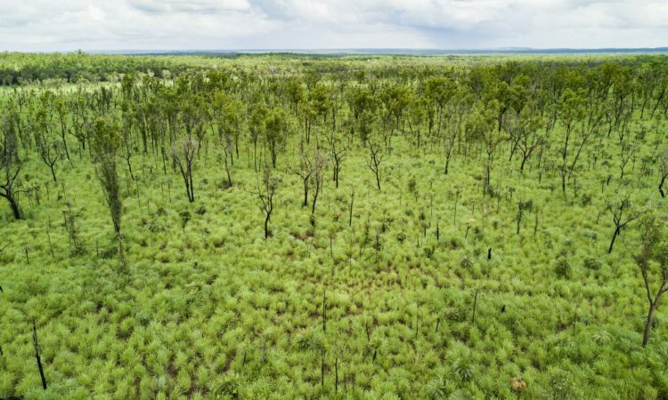
Invasive species mapping
Gamba is an invasive grass
Mapping Gamba grass is essential for biodiversity and bushfire management
Current Challenges:
lack of ground-truth data (labels)
large-scale mapping
Self-Supervised Remote Sensing?

Slide 41

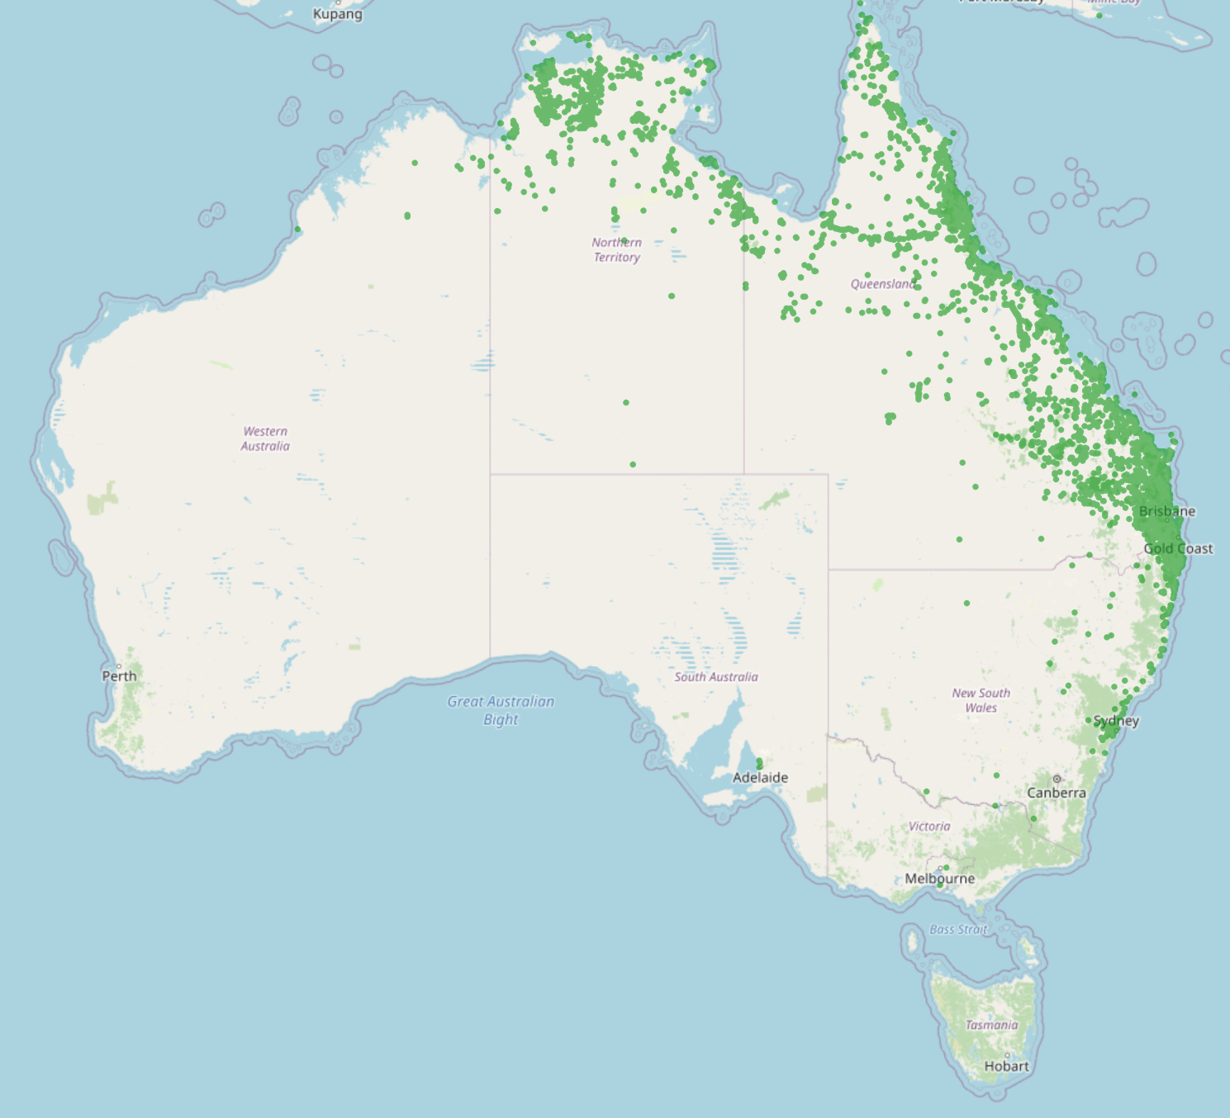
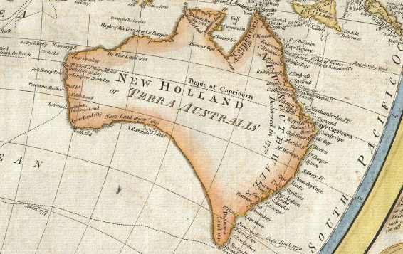
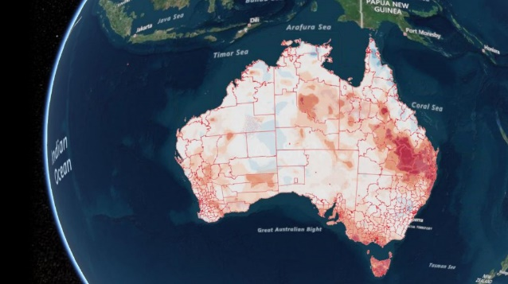
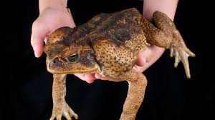
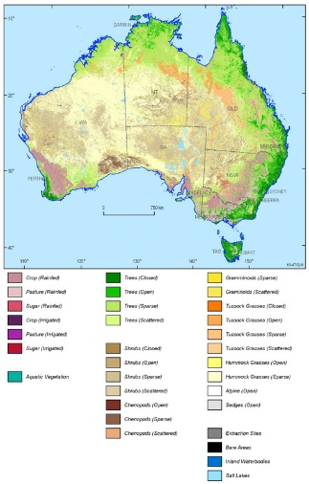
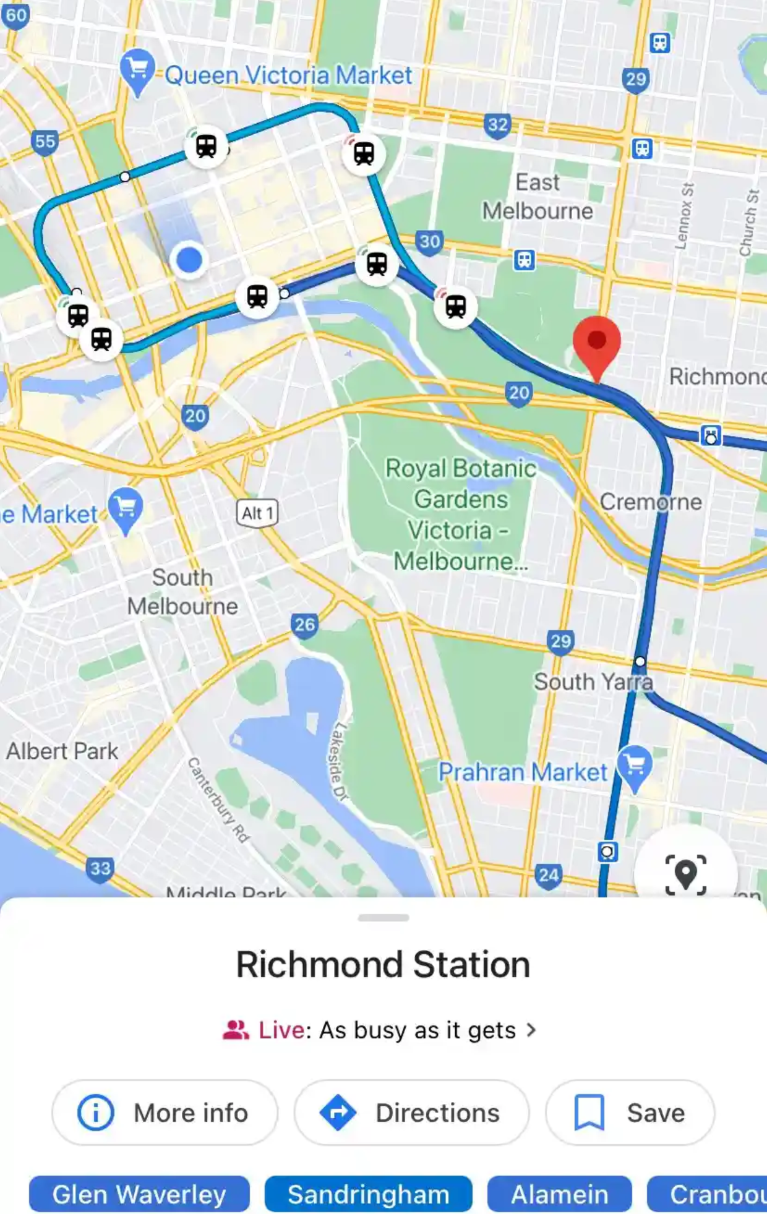

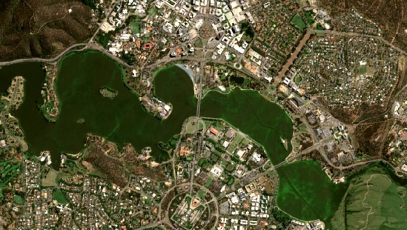
What is a Map?
Modern maps are navigational and surveying instruments
Paper
Electronic
Multi modal
Geoscience Australia
Samuel Dunn (1794)
Canberra Times (11/3/21)
The Guardian (25/2/21)

Slide 42
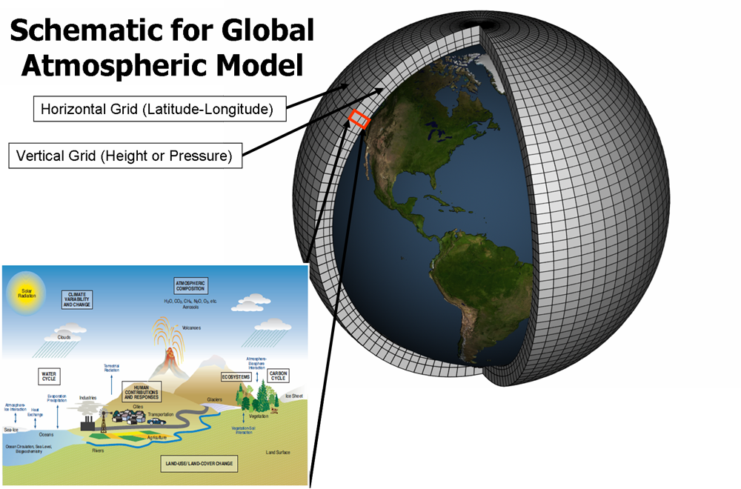
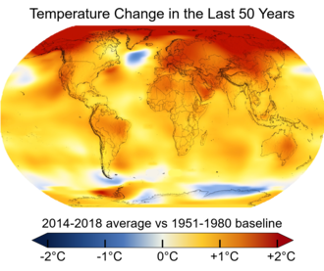
Climate Modelling
Global simulation models
Observations from heterogenous systems
Ocean, atmosphere, sea ice
Different time and space resolutions
Uncertainty propagation
Understanding climate variability, prediction and characterization
E.g. climate response to human action
Large scale latent state space models
Notes:
We are interested in climate models for which we have global simulation models and actual observations of the climate system. These observations can be at a very different time and space resolutions
We would like to model and propagate uncertainty on climate variables accurately by combining different sources of information in order to understand climate variability; make predictions at different horizons and characterize the climate system. For example, what is the climate response to human action

Slide 43
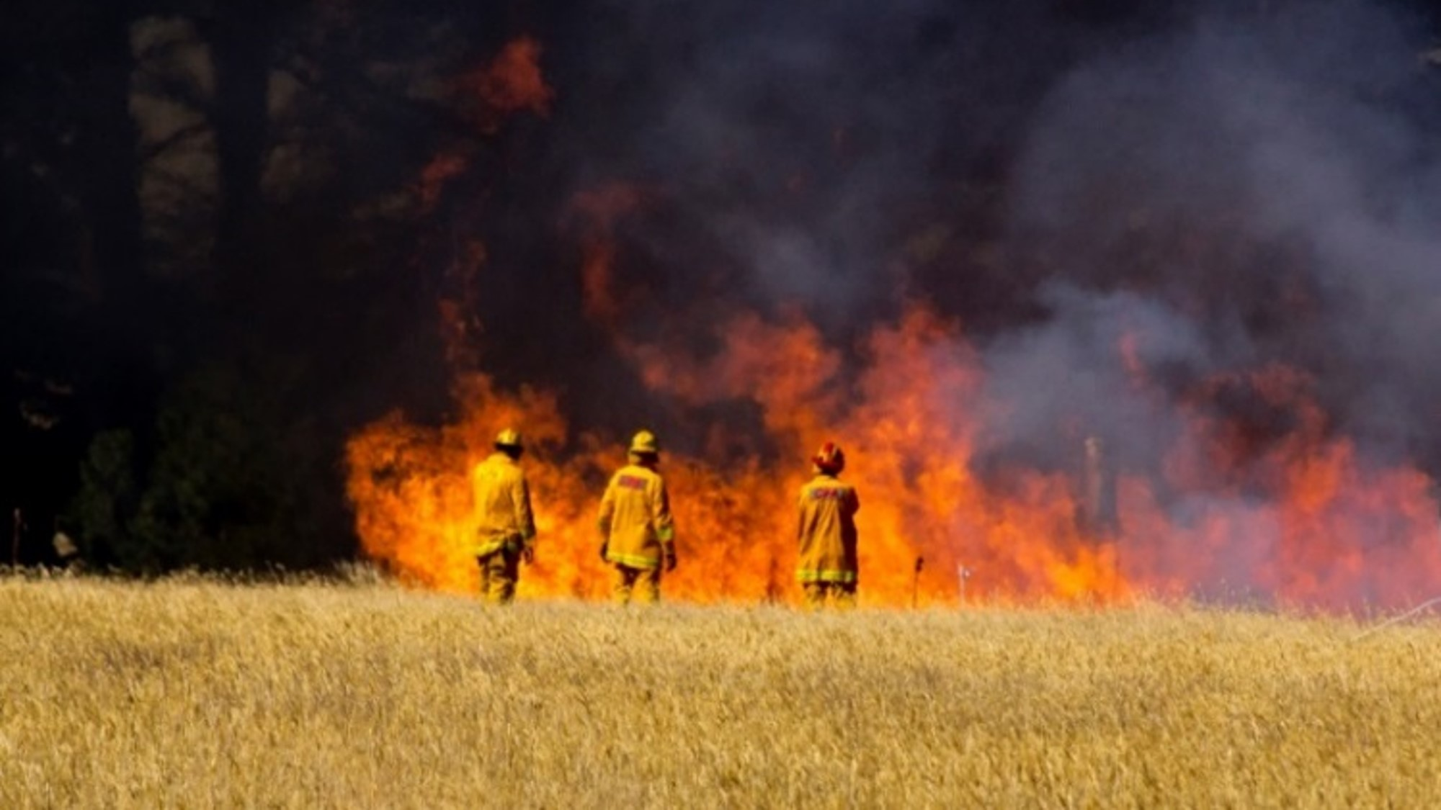

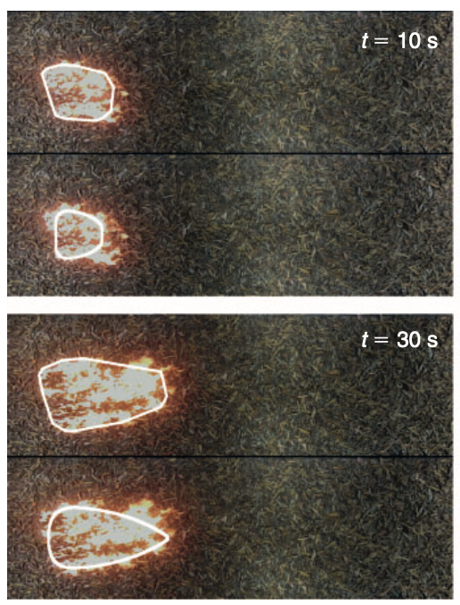
Bushfire Modelling
Key problems
How fast is the fire spreading?
Can we predict where the fire will go and when it will arrive at a given location?
Building predictive models that are a hybrid of data driven statistical machine learning and domain knowledge
Collaborating with CSIRO Data61 and L&W scientists in Victoria and the NT
Notes:
Recent events
Disclaimer
Contents
43

Slide 44
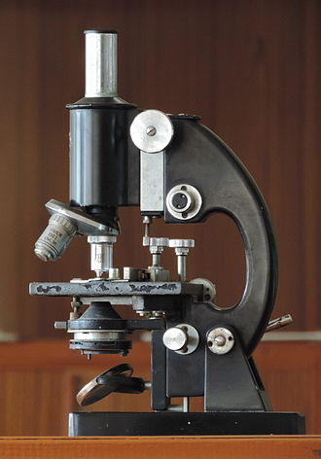
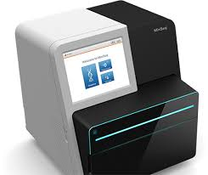
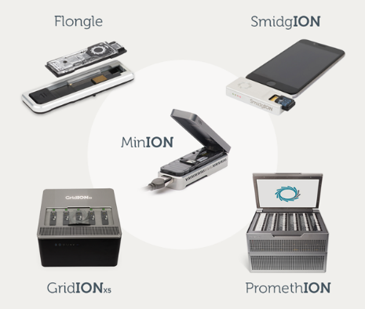
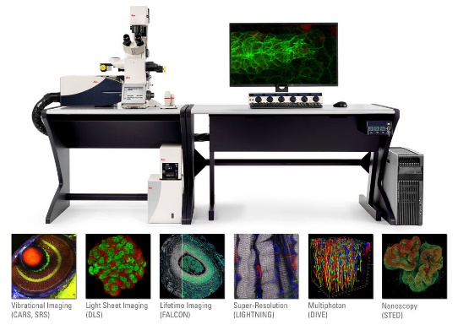
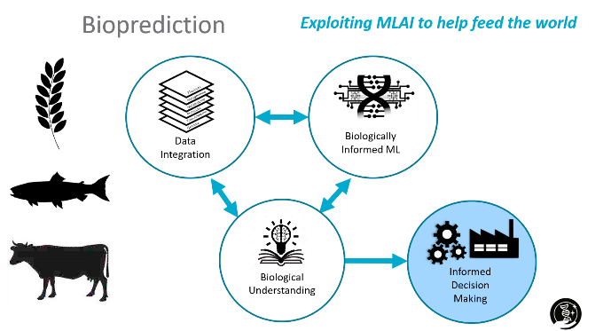
What is a microscope?
Modern biology is a study of systems
Optical
Sequencing
Multi ‘omics
Illumina
Wikipedia
Leica
Oxford nanopore

Slide 45
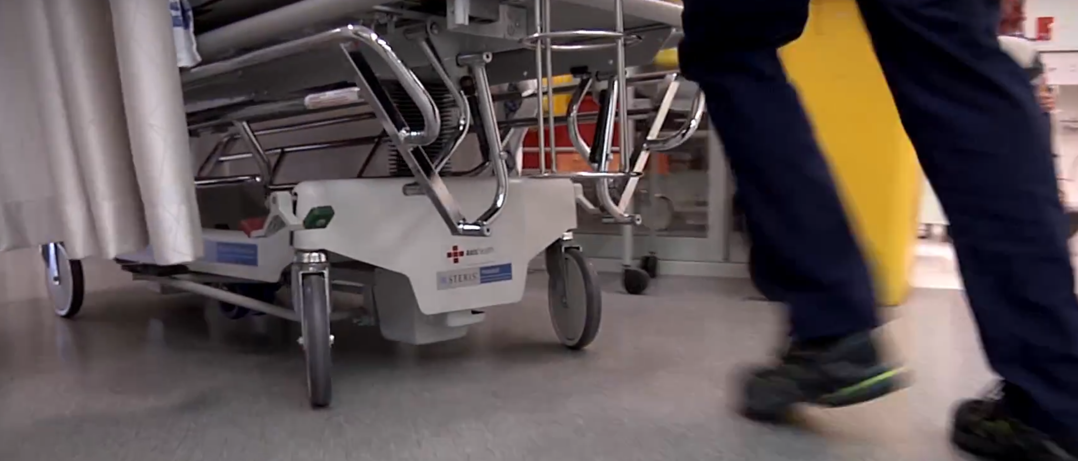
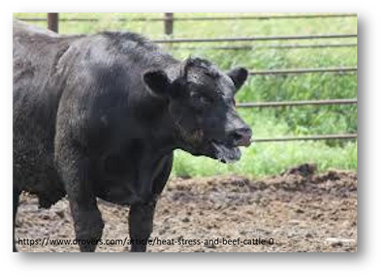

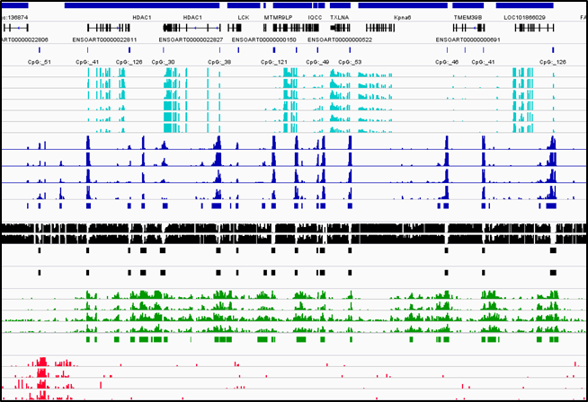



Sequences …
Patient records
Combine medical imaging with doctors’ notes
‘omic signatures of a good life
Can biological data be integrated to predict stress?
SNP

Slide 46


MLAI augmented SynBio
Design better RBS sequences to increase TIR
Ribosome Binding Site (RBS) controls protein expression level​
Translation Initiation Rate of Ribosome (TIR) binding sites is hard to predict and is expensive to label​
Use a predictor (Gaussian process) to estimate TIR for unobserved RBS sequences
Gaussian processes provide predictive uncertainty
Upper Confidence Bound (UCB) algorithm
Balance exploration and exploitation
Choose a batch of 90 constructs per round
https://research.csiro.au/synthetic-biology-fsp
Notes:
CSIRO has invested in another Future Science Platform on Synthetic Biology.
The specific problem we address is to increase the expression of a particular gene by changing the sequence that regulates the gene expression.
There are two regions which regulates expression, the promotor, and the ribosomal binding site (RBS).
There are two machine learning components (for two different MLAI tasks):
Regression. Gaussian process to do regression from RBS to TIR. In other words, for a given RBS sequence, predict TIR (the amount of gene expressed / how green it glows) A GP provides the mean as well as the predictive uncertainty. This is shown in the plots by the dark blue line and the light blue shaded area. Note that the true function is orange (and unknown)
Adaptive Design. We want to propose designs that maximise the value of the TIR (how green?). The upper confidence bound algorithm trades off exploration and exploitation. The two plots show one step of the algorithm. In the left plot, we select the green point, which has very high uncertainty (note broad confidence region). When we measure the value (shown on the right), we see that it is very low, and hence our regressor (the GP) updates its predictions. This leads to the next round where we select a different test point.

Slide 47

What is data?

Slide 48
Data is measured for a reason
A conceptual view of adaptive sampling
Consider the set of all possible things to measure
Think of the predictor output as a generator of features
Each generated features demonstrates the “importance” of a sample
Can get multiple features by a committee or ensemble of predictors
Adaptively choose the next thing to measure by maximising an objective (machine learning is about defining good objective functions)
hyperparameters
regularizer
sparsity
bandwidth

Slide 49
Looking forward…
What is the next generation scientific instrument?
Scientific discovery is an iterative process between data and knowledge
We observe data to infer new knowledge
Use machine learning to predict/infer unobserved data
We use domain knowledge to design new ways to capture data
Telescopes (like SKA) don’t look like tubes with glass
What are the next scientific instruments that rely on mathematics, statistics, and computing?
Notes:
Key message: Figure out how to use machine learning to assist researchers in scientific discovery.

Slide 50
Topics for OAMLS 2021
Representing biological sequences (8 Nov 2021)
DNA, RNA, protein sequences have categorical states
Machine learning expects numbers
High dimensions, low sample size (9 Nov 2021)
Sensors are getting cheaper
Samples (e.g. patients) are rare
Designing genomic sequences (this talk)

Slide 51

Parting thought…
The TV chef problem
“Actually running logistic regression, after feature vectors and labels were all set up, went particularly fast, leading to the remark: ‘and I thought machine learning was difficult’!
In this lies what I identify as the ‘TV Chef Problem’: if all the ingredients are prepared earlier, the task looks easy. However, this hides that sourcing and preparing those ingredients, as well as determining if you’ve even got the right recipe, is where the real difficulty and ambiguity lies.
Watching the TV Chef is effortless, but answering ‘is this meal right?’ can be really hard”
James Gardner, ANU undergraduate

Slide 52


















Come work with us
Machine Learning for Scientific Discovery
Work with an interdisciplinary group of EMCRs on challenging real world problems
Develop new methods at the interface between statistics and MLAI
Publish, network, and pitch new ideas
Have impact on industrial, environmental and agricultural programs
Open positions at https://jobs.csiro.au/
cheng-soon.ong@data61.csiro.au
https://research.csiro.au/mlai-fsp/

